Slide 1
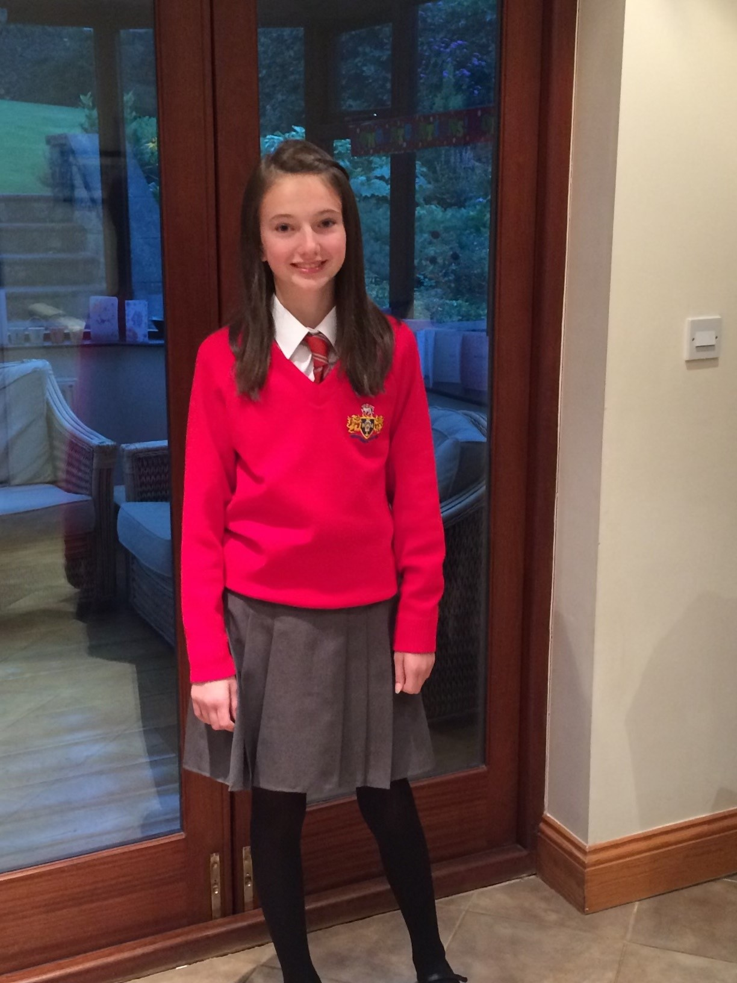
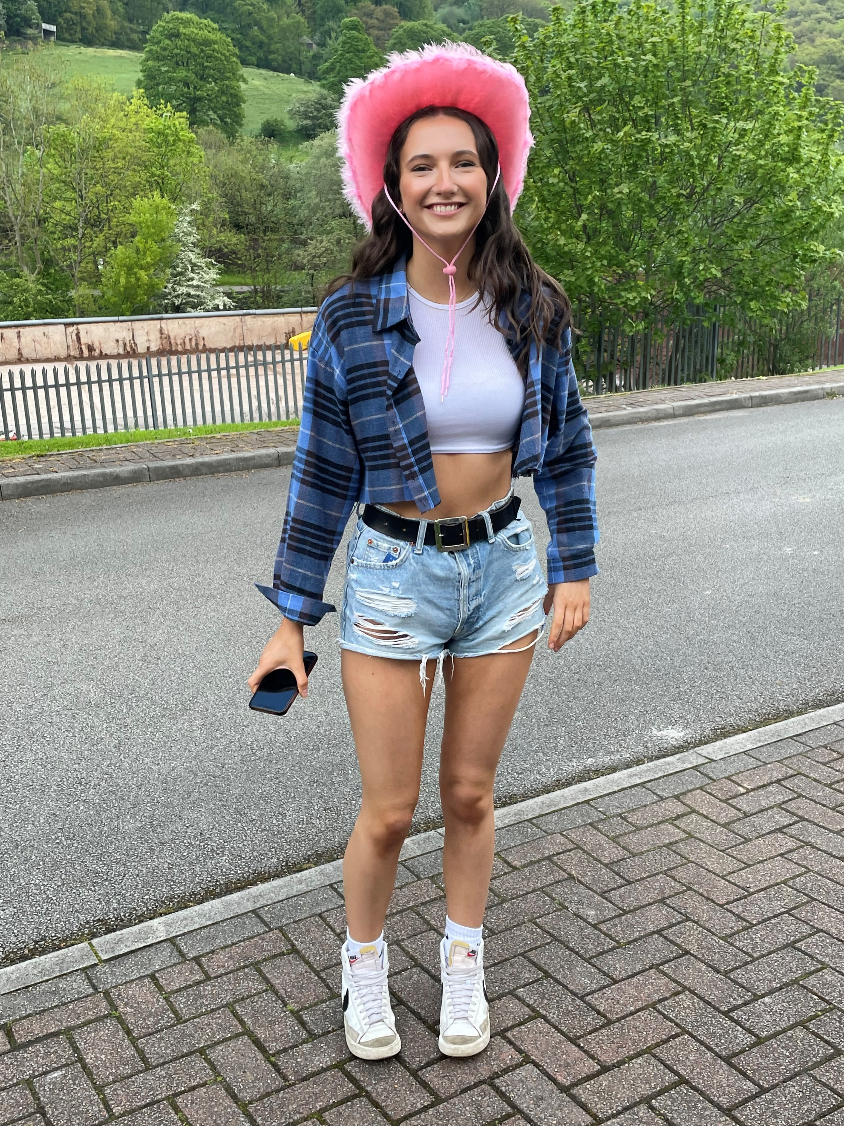
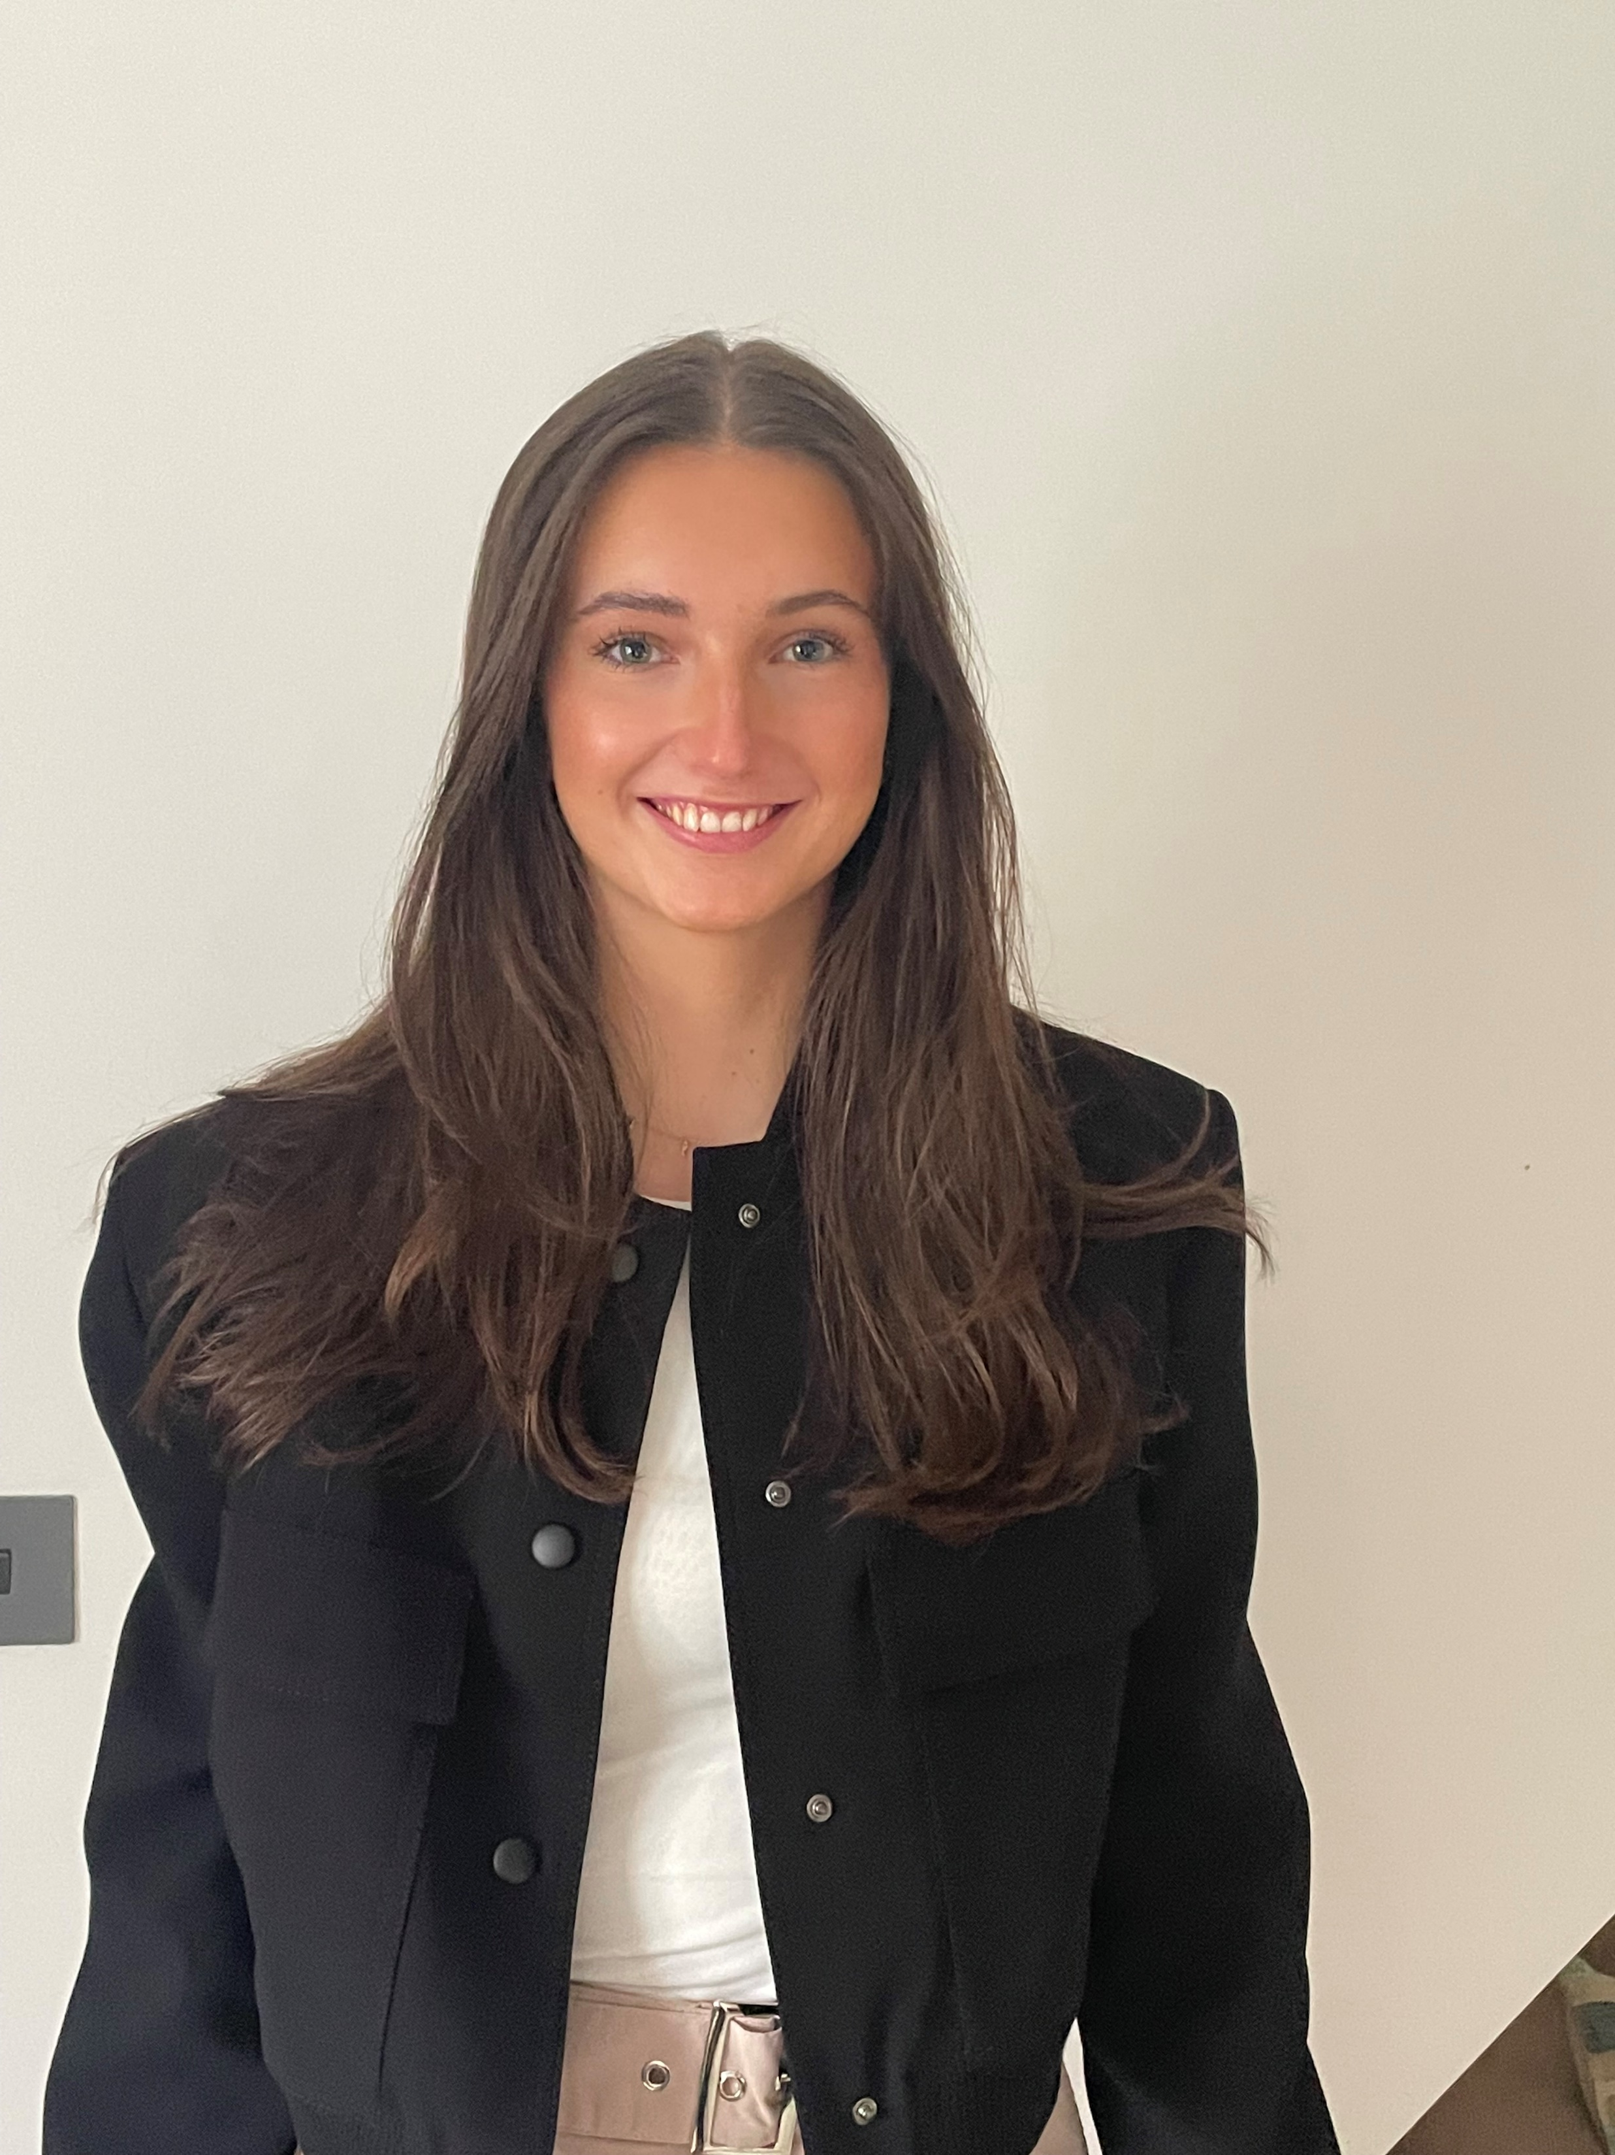
First day of year 7
Last day of sixth form
First day of work

Slide 2
Rate my Apprenticeship – www.ratemyapprenticeship.co.uk
Prospects – www.prospects.ac.uk
Find an Apprenticeship Gov Website - Find an apprenticeship (www.findapprenticeship.service.gov.uk)

Slide 3

Situation – describe the situation
Task – explain the task that needed to be done
Action – detail the actions that you took
Result – state
the result your actions created, which helped to rectify the situation

Slide 4

Top Tips
Use STAR
Have a bank of example answers
Research into the company
Have at least one question prepared for the interview
Apply to any roles you have an interest in, even if you don’t end up wanting the job the interview process is great experience!

Slide 5


What am I doing?
Project Management Degree Apprentice
Working at Mott MacDonald
Studying at Aston University
What will I achieve?
A BSc Degree in Project Management
Monthly salary with structured 6 monthly increases
No student debt

Slide 6
Why an Apprenticeship?
Practical Learning, on the job
Gain experience whilst learning
Apply what you learned in the classroom yesterday to a real working situation today
Improves employability
No student debt
Obtain a degree or another qualification
Develop industry connections

Slide 7
