Slide 1
For ASK partner reference
Before this session, please:
Consider the audience you are delivering this to and adapt as necessary, including size of cohort, age group and for students with additional needs.
Plan the session and adapt the slides as needed in terms of interactivity, internet/IT access and whether you will do any live demos of any websites.
Check the videos have downloaded to your device and are embedded in the slide should you wish to include them.
Hide or unhide the appropriate slides depending on your audience, the length of session and delivery method e.g. virtual or face to face.
Note, the script is not designed to be read word for word – please include what is relevant and adapt the script to the needs of your audience as appropriate.
Add in local examples and local labour market information where required.
Ensure you refer to the interactivity slide deck and the script to add interactive activities to your session.
Please review slide 2 for rough timings on each section of the session and adapt accordingly.
This presentation will roughly take 20 - 25 minutes.
PLEASE ENSURE THIS SLIDE IS HIDDEN BEFORE PRESENTING

Slide 2
For ASK partner reference
Content
Intro (1-2 mins)
What are apprenticeships overview (3-5 mins)
Higher & degree overview (2-3 mins)
Degree apprenticeships available and employers (3-5 mins)
Apprenticeship delivery & life as an apprentice (2-3 mins)
How to find and apply to higher & degree apprenticeships (3-5 mins)
Contact us / next steps (1-2 mins)

Slide 3
Higher and Degree apprenticeships
Notes:
My name is ‘insert name’ and I’m here on behalf of the Department for Education to talk to you about Higher & Degree apprenticeships.
Apprenticeships have really changed over the last few years. I think you are going to be surprised, and hopefully inspired, by the huge range of incredible opportunities now available to you through Higher & Degree apprenticeships.
Although some of you may already know what you’re planning to do when you leave school, it is important you listen carefully so that you can keep your options open should your plans change.
And for anyone who hasn’t quite decided what they want to do next when they leave school, I hope today will be really useful in helping you to understand your options.

Slide 4
Employed
Off the job
Intermediate – degree level
What are apprenticeships?
Paid a salary
Typically 1-6 years
Real responsibilities
600+ different apprenticeships
Contract
Not the easy option
Notes:
But before we look at Higher and Degree apprenticeships specifically, it’s important to cover what an apprenticeship actually is.
An apprenticeship is a real job, with a real employer, where the apprentice works full-time whilst also studying towards a qualification.
So you could be an apprentice working for Sky as a journalist, for example, whilst also studying and gaining a qualification in journalism.
PAID A SALARY
As it’s a real job, you will earn a wage – and it can be a really good salary too! The salary of an apprentice can vary from employer to employer. Legally, an employer must pay an apprentice the National Minimum Wage for apprentices, which is now £6.40 per hour. This is lower than the normal National Minimum Wage, but it recognises that some people will be going into their first job with little or no experience.
The good news is that lots of employers pay a lot more than the National Minimum Wage for apprentices, with some local employers offering average salaries of £19,739 and other national employers even offering starting salaries over £20 - £30,000.
Presenter note: Please include local example you are aware of.
I have pulled together some local vacancy information which I will show you shortly, so you can see some real examples of local and national apprenticeships available and see what types of salaries are being offered.
It’s important to remember that if you see an apprenticeship you’re interested in, don’t be put off by the pay if it’s low: there’s room for progression and working your way to the top of an organisation.
CONTRACT
You will also get a contract of employment, holiday pay, annual leave etc – exactly the same as any other member of staff.
STUDY AND WORK
The apprentice will spend the majority of their time ‘on-the-job’ (doing their role), and a minimum of at least 6 hours per week ‘off-the-job’, which means studying or working towards their qualification.
This study element (off-the-job) would takes place with a training provider, who will help them to achieve the qualifications and make sure they complete their apprenticeship.
Training providers could be colleges, universities or independent training provider organisations, who deliver the training/teaching element of the course.
The employer will also support the apprentice, helping them to gain qualifications and valuable new skills and experience. As well as their time, employers also pay the fees of the apprentice’s training, showing their investment in the apprentice’s development.
TYPICALLY 1 – 6 YEARS
An apprenticeship typically takes 1 to 4 years to complete (sometimes up to 6 for some areas like a Solicitor). As a minimum, all apprenticeships must last for a minimum of 12 months.
The total duration will depend on the delivery model that the employer selects (how the mixture of training and working is delivered), the level (which we will explain later) and the subject they are studying.
600+ STANDARDS and INTERMEDIATE – DEGREE LEVEL
There are more than 600 different apprenticeship standards covering many different levels of apprenticeships, from Level 2 (which is the equivalent of 5 GCSEs), all the way up to Level 7, which is the equivalent to master’s level. So you can actually work your way towards gaining a degree or masters through an apprenticeship. We will discuss this more shortly.
REAL JOB = RESPONSIBILITIES and NOT THE EASY OPTION
As I said before, it’s a real job and so it’s important to remember that apprenticeships aren’t the ‘easy option’. Holding down a full time job and studying takes a certain skill and commitment, and it won’t be right for everyone.

Slide 5
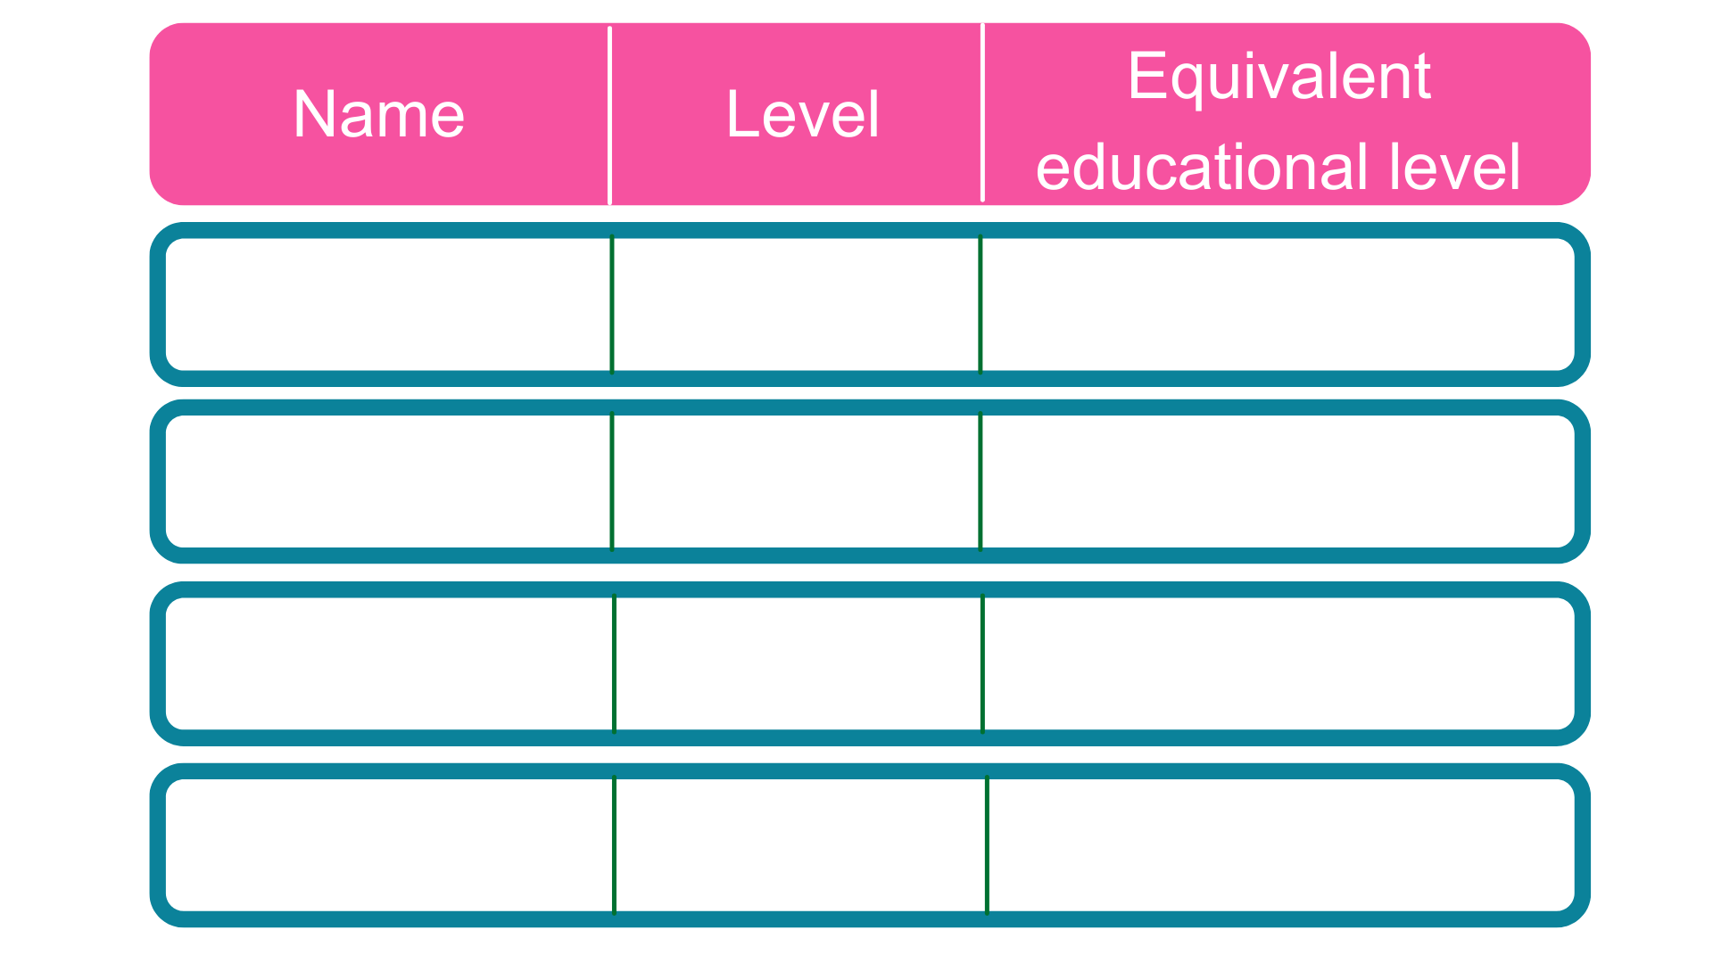
The levels of apprenticeships
Intermediate
2
5 GCSE passes at grade 4-9 (A*-C)
2 A Levels / Level 3 diploma / International Baccalaureate
Advanced
3
Higher
4,5,6 & 7
Foundation degree and above
Degree
6 & 7
Bachelor’s or master’s degree
Notes:
Each apprenticeship has a level which falls into one of the four categories above: Intermediate apprenticeships, Advanced apprenticeships, Higher apprenticeships and degree apprenticeships.
The equivalent educational level column helps to explain what level the qualification at the end of the apprenticeship will be in comparison to more familiar qualifications, like GCSEs and A Levels.
So you can see that if you do a level 3 (advanced) apprenticeship, once you have qualified you’ll have gained a qualification that is equivalent to 2 A Levels, a level 3 diploma or other equivalents, like IBs or BTECs.
You can now start an intermediate apprenticeship and work all the way up to achieving a degree or master’s through the apprenticeship route.
Higher apprenticeships cover all levels from 4 through to 7.
Level 4, 5, 6 and 7 are equivalent to a Foundation Degree and above.
A degree apprenticeship contains a Level 6 or 7 Bachelors or Masters degree or equivalent level 6 or level 7 qualification.
The level of apprenticeship you start at will depend on the kind of job that you are applying for.
It’s really important not to be held back by only looking for a particular level e.g. degree apprenticeships. Apprenticeships work a bit differently to school which can be confusing, as lots of students think that they should progress onto the next level, so if you leave after GCSEs you should do a Level 3 and if you finish after A Levels you should go for a degree apprenticeship, but this isn’t always the case.
Depending on the sector and apprenticeship, it may be that you need to start at advanced or higher level and work your way up, or that brilliant apprenticeships are only offered at certain levels – for example, Journalism is only offered at Level 5 because that is all the industry requires.
Equally, you may be entering a completely new sector or industry that you haven’t studied or worked in before, and so may need to do a Level 2 or 3 to enter the world of work and start at the correct level of understanding.
Doing a job is completely different to getting a GCSE or A Level and that’s why it can be a bit confusing.
It is very important to keep an open mind so that you can explore all of the opportunities available and have multiple options available when applying.
The duration of your apprenticeship will depend on a number of factors including the delivery model that your employer selects and which level of apprenticeship you are studying.
As a minimum, all apprenticeships must last for a minimum of 12 months.
Higher and Degree apprenticeships are more likely to last for 3 to 5 years. Some degree apprenticeships actually last for 6 years.

Slide 6
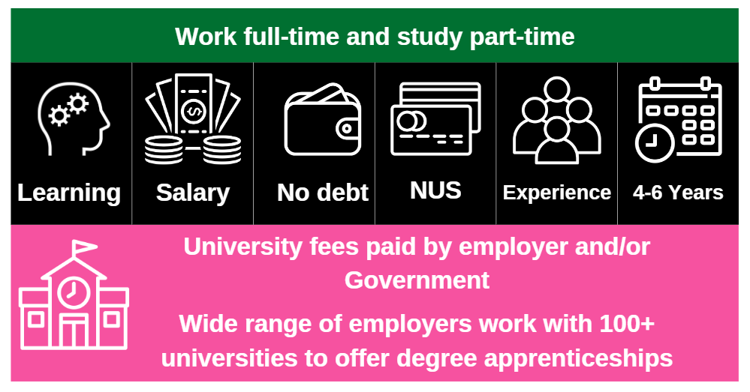
Higher and degree apprenticeships
Notes:
Higher and degree apprenticeships are a real alternative to following the traditional route of going to University as a full time student.
They offer all the benefits of higher education with none of the cost. You will not only be learning, but earning a salary, from day one. With a degree apprenticeship, you’re much less likely to build up any debt. Your tuition fees are paid for by your employer and the Government, so you will not be expected to pay £9000 a year.
More than 100 Universities in England offer degree apprenticeships now.
The students on degree apprenticeships are entitled to exactly the same benefits as other students, so you will still have access to the student union, sports facilities, clubs, societies and student discounts.
In the past, going to university was seen as the best way to advance your career to a higher level. But with the current level of competition for jobs among graduates, it might not be the best route for you. With an apprenticeship, you have the competitive advantage of gaining at least 3 years’ work experience whilst completing your degree.
You will study the same academic course content as if you were at university full time, but are able to put it into practice straight away in the workplace while also learning from colleagues and staying up to date on the latest trends and technology in the sector.
But remember – it’s hard work as a degree apprentice. You’ll be working full time and fitting in the equivalent of a full time degree alongside. It might take a bit longer than studying full time – for example, 4 years instead of 3, but you’ll achieve exactly the same degree.
No matter what kind of career you want to follow, you need to do your research and find out if there’s a way to get to the role you want through an apprenticeship. That way, you can decide if you would prefer to study full time at college or university, or if you would prefer to go into work as an apprentice and gain qualifications and experience on the job from day one.
Everyone has different learning styles and both routes offer a different way to learn and start your career. No route is better than the other, it is just about which is best/right for you.
Remember, you can apply for apprenticeships alongside applying for university and then you can decide what is right for you later on.

Slide 7
Aerospace engineer
Architect
Chartered legal executive
Dietitian
Degree apprenticeships available
Aerospace engineer
Doctor
Social worker
Storyboard artist
Solicitor
Project Manager
Senior Journalist
Marketing manager
First officer pilot
Notes:
There are now more than 240 different higher and degree apprenticeships available covering a huge range of job roles. Some of them are listed on this slide.
For example, you could become an architect or a solicitor.
You could also do an apprenticeship to become a town planner, a cyber security professional, an Ecologist, a Laboratory Scientist or even a Police Constable.
If you want to see the full latest list of apprenticeships, I would recommend that you visit ‘The Institute for Apprenticeships and Technical Education’ website / I have copies of the A-Z guide of apprenticeships.
This allows you to filter and see which apprenticeships are in development and at what stage of the approval process they are at. We will include a link to this website at the end of the presentation.
Suggested interactivity - engage the group in a discussion around these questions:
Are there any that surprise you?
Are there any that you’d look to like up now (using the IFATE website) to find out a little bit more about them and what they involve?
What other areas are you interested in? (Facilitate discussion around if apprenticeship opportunity available)

Slide 8
Which employers offer apprenticeships?
Notes:
Presenter notes: Please update this slide with local companies if you feel that the logos are not representative of your area. Please include small and large organisations.
Equally, the range of employers offering apprenticeships is incredible.
This slide shows you some really familiar logos of big companies in England who all recruit apprentices.
Some of these employers may not be recruiting currently, but you will be able to track their recruitment updates on their websites or social media.
Around 50% of apprenticeships started are with large companies like this, but 50% will be with smaller local companies.
It can be tempting to think that the ‘best’ apprenticeships are just with the big, well-known companies, but many of the smaller employers have absolutely brilliant schemes that enable fast-track career progression for their apprentices, so it’s really important to do your research and not to ignore smaller employers because they can be just as good.
Presenter notes: Please include an example of a local company in the town that you are delivering in. An example of a small local company is…X who employs apprentices in job roles like X and X etc.

Slide 9
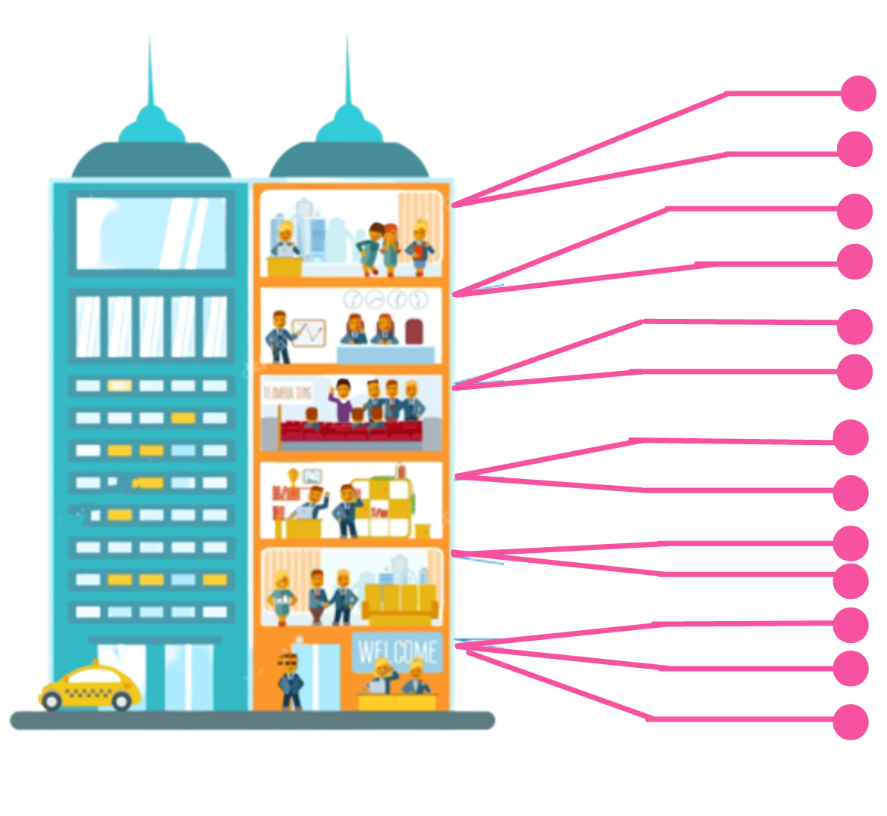
Logistics
IT & Cyber Security
Look inside the company
Data Analytics
Sales
Business Development
Marketing
Human Resources (HR)
Finance
Legal
Facilities Management
Security
Customer Service
Training & Development
Notes:
You also need to think about the different roles that a company might have.
For example, if you want to work in finance – you shouldn’t just look at the big finance and accountancy companies. Lots of other companies will have their own in-house finance departments where you will still have access to a huge range of experiences and opportunities.
It can be a good idea to take some time to look at the different departments that a company has and see if they offer an apprenticeship in that area.
For example, you could work as a solicitor for Coca-Cola, a website designer for Jet2.com, as a fire safety engineer apprentice for the Government. There are thousands of different opportunities!
Presenter notes: Please update the example if you feel that mentioning Vauxhall or Coca-Cola are not representative of your area.

Slide 10
How an apprenticeship is delivered
Notes:
There are many different ways an apprenticeship can be delivered.
It will differ, depending on the organisation and also the training provider delivering the apprenticeship.
For some apprenticeships, off-the-job learning is delivered at work. This means a tutor will come to you to teach you independently at work, or perhaps in a cohort with other apprentices if the employer takes on multiple apprentices.
Another method of delivery is attending college, a training provider or a university. You might attend once a fortnight or once a week with other apprentices who work for other companies in the local area. For some of the bigger organisations, they often send their apprentices to college/university for a week at various points in the year. It depends on their workload and what works best for the company.
Many apprentices also find that they will carry out some learning online, which has increased more recently. It really varies.
Presenter notes: please update this slide with local examples if you know of any. E.g. For example, apprentices who work for X will learn by attending X for X days/weeks etc.

Slide 11
Life as an apprentice
Notes:
Let’s talk about some questions that I get asked a lot
Do apprentices miss out on having a social life? It is true to say that apprentices will not have the exact same social life as full-time university students because they are young professionals and need to be in work every day. They do have great social lives however, still socialising in the week and at weekends and the bonus is they are earning money so can afford to go out for nice meals, go shopping and go on holiday, for example. Many apprentices will of course also socialise through work, particularly if in a cohort of apprentices. Many employers and providers will support their apprentices to do social events, networking activities and create lots of different ways for people to meet each other. For example, a provider in London, Multiverse, run monthly pizza and drinks social nights for apprentices who study with them so that they can get to know each other. They still experience the social side, just in a different way.
Degree apprentices get the same benefits as other university students such as membership of the student union, access to societies, clubs and events.
Presenter notes: Add in local examples here of ways in which employers/providers support their apprentices.
Can apprentices move away from home? Many apprentices do relocate. Sometimes the employer might help with this by putting them in touch with other apprentices for shared accommodation. Other apprentices organise this themselves, then once they are settled in at work, they arrange with other apprentices to get a shared house.
Are apprenticeships the easy route? Apprenticeships are actually very competitive to get on to, particularly for Higher & Degree apprenticeships, as so many young people are attracted by the idea of gaining a degree with no debt and getting lots of experience. Plus, the apprentice is studying a degree alongside a full-time job, so apprenticeships are certainly not the easy route.
So you must do your research and put as much effort in to preparing for your application process as you would for UCAS.
Suggested interactivity - you could replace this discussion with videos of apprentices dispelling these myths or by running it as a Q&A with an AAN/apprentice attending:
e.g. Rolls Royce have short videos on their website and Vacancy Snapshot profile where apprentices answer these questions themselves. They are light-hearted and fun case studies.
You may know of other videos that can be used.
Suggested interactivity - engage the group in a discussion:
Do you have any other questions about life as an apprentice or anything you wanted to check/ask?

Slide 12
How to find a higher/degree apprenticeship
Notes:
What is the application process and where do you start?
As apprenticeships are real jobs, there is not just one system to find them like the standard UCAS format for full-time university.
There are various platforms now that you can use to help streamline some of this searching.
Find an apprenticeship is the government search portal for live apprenticeships. It’s a huge job posting of apprenticeship vacancies that are being advertised now (today) and features all levels; Intermediate, Advanced and Higher & Degree. You can register and set up alerts to tell you when the types of apprenticeships you’re looking for go online and you can also apply directly to the employer.
UCAS has a dedicated apprenticeships page on their website and you can now apply for degree apprenticeships through UCAS. A great benefit is that, if you’re still not sure which direction you would like to take, applying for an apprenticeship does not usually take away from your 5 options. You can still apply for 5 full-time University choices, as well as many degree apprenticeships as you like. Then when you get to the summer and see what offers come back, you are in a much better position to make a decision based on lots of offers.
Employer websites are also a hugely important source as many employers will advertise their vacancies directly, particularly for their Higher and Degree schemes which may have a more rigorous application process. Make sure to follow their social media accounts and set up any alerts that you can to find out about their vacancies and when they’re recruiting.
The Higher & Degree vacancy listing is also a really useful document that is shared in November and then an updated version is released again in February. This contains a list of hundreds of higher and degree apprenticeship vacancies that are open for application, and gives key information about the employer, the apprenticeship, the salary, location and where to apply. This will be shared on the Amazing Apprenticeships website and apprenticeships.gov.uk.
Additionally, we have spoken to lots of apprentices and quite often, they will say that they actually heard about their job through a family member or friend. So make sure you tell everyone you can think of that you’re looking for an apprenticeship and you never know what might come through!
There are lots of other job search sites out there, as well as sites you can find further information, such as:
Amazing Apprenticeships website to get information on new vacancies and for employer area
Local LEP opportunities portals (if applicable)
Local websites (Presenter to add)
Definitely spend some time looking into the different types of employers. There will be a real mix from your local council who might have a jobs page for young people, through to bigger recruitment sites too.

Slide 13
www.yorkshireapprenticeshipservice.co.uk
Notes:
Presenter notes: We would expect this slide to be updated by the delivery partner to reflect local opportunities by searching through Find an Apprenticeship
As a company, we developed the Yorkshire Apprenticeship Service as a one-stop-shop for our area. This is a localised version of the FAA. We wanted our local schools to have access to a service curated just for them.
The site includes vacancies across Yorkshire that can be searched by postcode, industry or keyword. It includes application advice, FAQs, support for parents/teachers and a range of examples from our previously mentioned career starter apprenticeships.
This can be found at yorkshireapprenticeshipservice.co.uk or you can scan the QR code to save it on your phones for later, or alternatively take a picture of the web address.

Slide 14
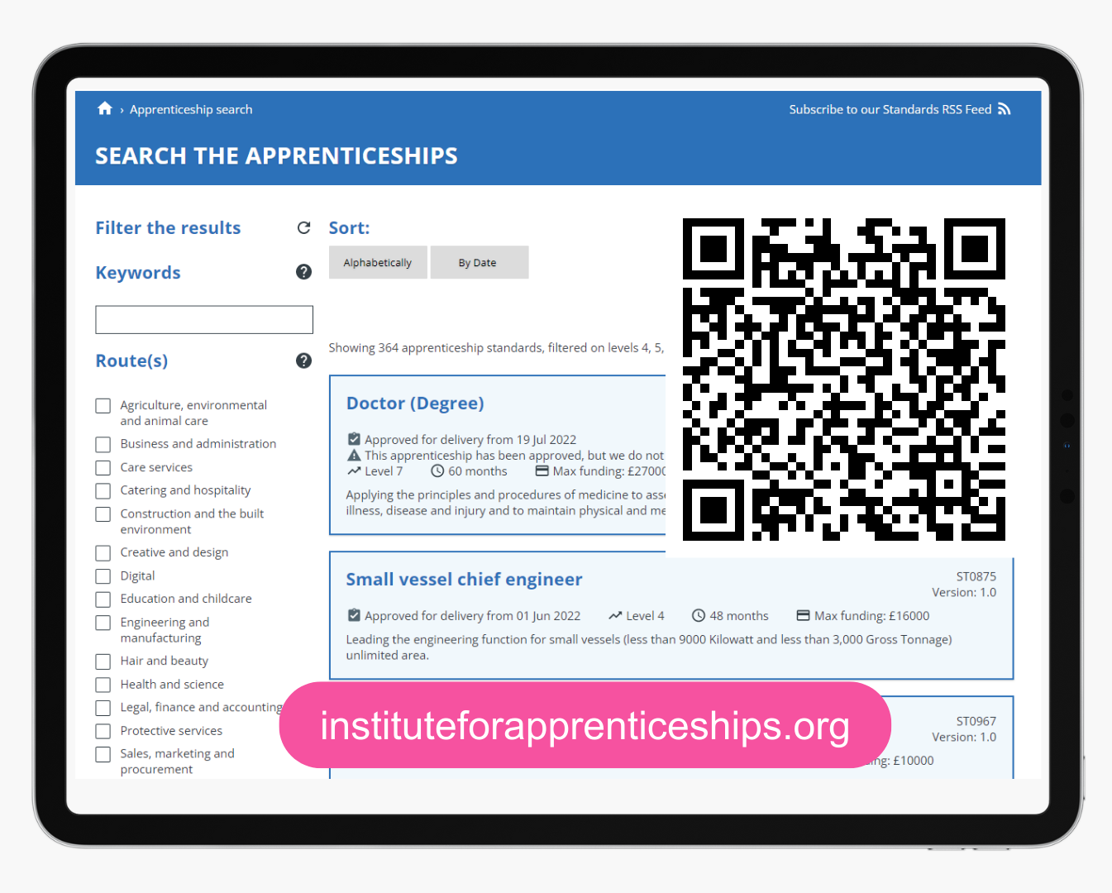
Institute for Apprenticeships and Technical Education
Notes:
I also mentioned earlier that I would share the link to the IFATE website where you can see a full list of the different higher and degree apprenticeships available.
The link is available on the screen here. I will also share the links with your teacher after this session.

Slide 15
date
Weekly salary
Annual salary
Job opportunity | Level | Annual salary or weekly pay
Chartered Management degree programme Morrisons Supermarkets plc UK wide | 6 | £22,000
WSP – Leeds. Several Degree level Construction/Engineering posts | 6 | £18,000
PELL FRISCHMANN CONSULTANTS LIMITED Civil Engineering - Wakefield | 6 | £18,000
Social Worker Degree Apprentice – Calderdale Council | 6 | £24,496
Jet 2 – Data and Web Analysis Higher level apprenticeship | 4 | £20,000
WYP - Police Community Support Officer Apprenticeship West Yorkshire Police | 4 | £23,100
Recent Higher and Degree Apprenticeships in the local area
Notes:
Presenter notes: please update this slide with relevant examples for your audience
Search through Find an apprenticeship using the establishment postcode and find some interesting jobs. Please also use other sites to source H&D vacancies, as these can be spread out in different places.
Try to find a selection of closing dates so that you can reinforce the need to be using Find an apprenticeship regularly
Try to find a range of salaries so that you can show that there are employers who are prepared to pay more
Try to find a job title that might sound a bit confusing and then explain what that role really is – make it sound exciting and explain that they should not be put off by the titles of some jobs, it’s important they read the job advert attached to it.
Think about STEM vacancies. Can these be showcased more?
This slide shows a range of vacancies that I could find.
You will notice that they have come from a variety of places and they all have different closing dates – this is one big difference to applying for university.
If you do see a closing date, it’s important that you don’t wait until the very end to submit your application. We are now finding from talking to employers that if they receive a huge number of applications, they may decide to close the application window early.
You will also notice the range of different salaries too – this is because employers can decide what to pay (as long as it meets the national minimum wage for apprentices of £4.81)
Higher and Degree apprenticeships can be really competitive to get into. They are still quite new and so we are seeing more employers offering them, but there is lots of interest in them and so it’s important to not rely on just one application or option, but to have back up options by applying to lots of different vacancies.
As I said before, I would not rule out the Level 3 vacancies either, which can be a great way to get into an organisation and then to progress onto a degree apprenticeship afterwards.
Try also not to be too discouraged if you do not get the first higher or degree apprenticeship you’re applying for, it can take a few applications to find the right one for you. We have met some apprentices who have applied 10+ - 20+ for different vacancies, but eventually found the right option for them.
There is also lots of support available to help you to prepare for the recruitment process, including interview support, CV and application support, as well as how to prepare for assessment days.
We can work with your teacher to support you / you can find lots of useful information at apprenticeships.gov.uk or Amazing Apprenticeships, or by visiting employer websites where they typically provide hints and tips themselves.

Slide 16
You can move to a new place to undertake an apprenticeship in the same way you could for any other type of job.
Relocating for an apprenticeship
Things to consider:
Finances
Accommodation
Living in a new area
Support network
Notes:
As well as looking at local apprenticeships, remember it is possible to relocate for an apprenticeship. Relocation for apprentices is on the rise, with many employers realising that in order to attract the widest pool of talent to their businesses, they may need to recruit from beyond their local area.
There will always be cost implications when you are moving out of home. Some employers may offer relocation expenses, but this isn't a given. You could do some research on what is offered on employer websites when you are looking for a role, for example by reading case studies from other apprentices they have employed.
If you find great apprenticeships that would require you to relocate, talk to your parents / carers about what they think and what support they could offer you if you relocate. Think about who you might know in the area(s) where there are interesting apprenticeship opportunities, and talk to them about whether they could help with accommodation or support once you're there.

Slide 17
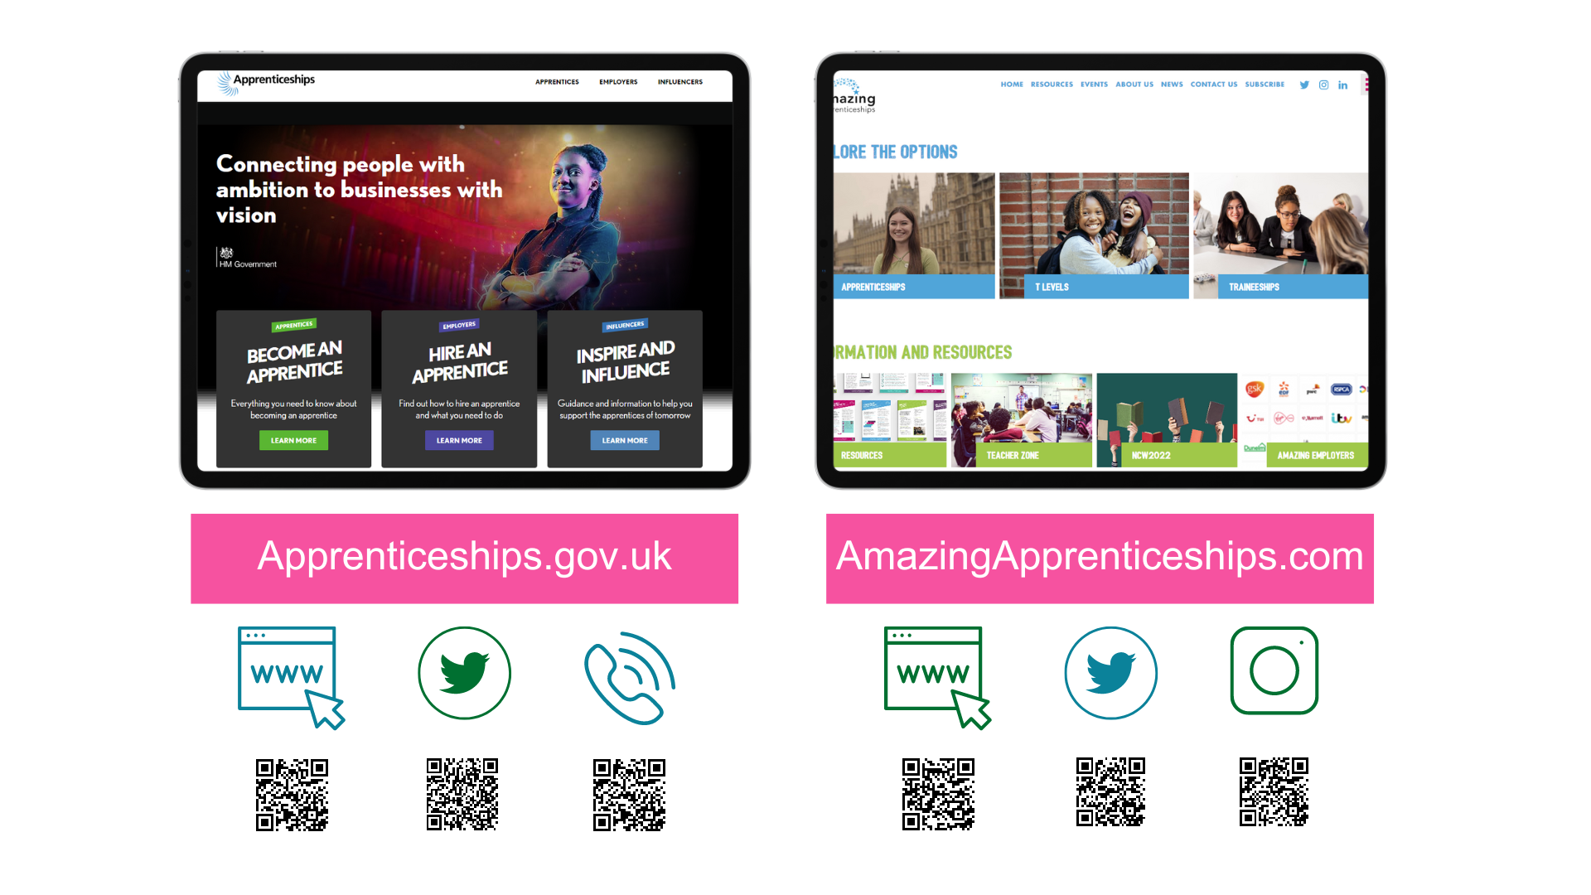
Contact us
amazing
Notes:
Thank you so much for listening today, it has been an absolute pleasure meeting and talking to you all.
I hope that you have found today useful.
Remember, there is lots of support out there to help to guide you into the right choice for you after this session.
You can speak to your teachers here at school who can point you in the direction of the Careers Leader who will be able to tell you more about degree apprenticeships. They are also in touch with us and so we can answer your questions/come back in and run further sessions if lots of people still want further help.
There is also lots of support and information out there to help you to stay up to date with the latest apprenticeships information.
Visit www.apprenticeships.gov.uk for more information on apprenticeships and resources to help you to search for and apply for apprenticeships.
You can also follow @apprenticeships on social media for apprenticeship updates or get in touch with the details on the slide.
To find more films, apprentice stories or learn more about apprenticeships or T Levels, you can also go to www.amazingapprenticeships.com/student-zone.
You can also contact the National Careers Service, who as we said, can help to give you advice and guidance.

Slide 18
Notes:
You can also visit the National Careers Service website to find out about all of the education and training options available to you once you’ve finished school.
The website gives you information about 9 different options:
3 x study options
A Levels
University (Higher Education)
Higher Technical Qualifications
2 x work options
School leaver schemes
Supported internships
3 x work and study options
Apprenticeships
T Levels
Vocational Technical Qualifications (VTQs)
The website helps to explain what the different options are, how they are similar/different to each other, who they are for and where to find out more information
You can find the website through the link on the slide or by scanning the QR code - https://nationalcareers.service.gov.uk/explore-your-education-and-training-choices

Slide 19
Any questions?
Notes:
But for now, are there any questions at all?
Suggested interactivity: Please do a poll/raise of hands to gauge understanding at the end of the session:
- Please can you raise your hands/complete the poll if you’re considering applying for a higher and degree apprenticeship:
Yes, I am considering applying for a Higher and Degree apprenticeship
Yes, I am considering applying for all apprenticeship levels
No, I am not thinking about applying for an apprenticeship
Thank you so much again for all of your engagement and input today. I’m really excited for you all as you think about your next steps and begin looking at all of the different opportunities open to you.
For any further questions, please pass them onto your teacher and we can follow up with them afterwards.

Slide 20
Student evaluation form
Notes:
Presenter notes: Please unhide this slide to be included where appropriate. This slide will be hidden by default.

Slide 21
Anything to promote?
Notes:
Presenter notes: Any further call to actions should be included here:
Book onto the next session e.g. reg workshop
Let us know if you make an application
Upcoming event – e.g. Spotlight talks (World Skills), NAW, NAAs etc
Please complete our short survey
Close session
This slide will be hidden as a default so please unhide it should you need to include any information.

