Slide 1
Student Finance 2017-18
Liam Bunce
Schools and Colleges
Liaison Officer

Slide 2
What we’ll cover
1) What support?
2) How do you get it?
Student Finance England provides financial support to students entering higher education in the UK, on behalf of the UK government.
https://www.gov.uk/student-finance
3) When and how to repay
4) Managing your money

Slide 3
1) What support can you get?
1
Tuition fee
loan
3
Additional
support
2
Maintenance
loan

Slide 4
Tuition fees
Public universities can charge up to £9,250* per year in tuition fees.
Students do not have to pay this up front.
A tuition fee loan is available to cover the fee charged by a university or college.
*The Government is introducing changes which mean that Undergraduate tuition fees may be able to rise with inflation (RPI-X) from September 2017.

Slide 5
Tuition fee loans
These don’t depend on your household income or circumstances – you’ll get whatever the university charges for tuition fees (up to £9,250).
Your tuition fee loan will be paid directly to your university at the start of the academic year.
Your tuition fee loan is repayable, but only after you’ve graduated and are earning over £21,000 per year.

Slide 6
Maintenance loans
A loan paid directly to the student in 3 instalments across the year, to help with living costs while at university.
Accommodation
Food and drink
Transport
Bills
Entertainment
Mobile phone

Slide 7
Maintenance loans
£
All eligible students can get some support towards living costs and this is paid into your bank account each term.
The amount of maintenance loan you can get depends on where you live and study, as well as your household income.
Maintenance loans have to be paid back but not until you’ve left university and your income is over £21,000 a year.

Slide 8
Maintenance loans 2017/18 Maximum levels
Where you live and/or study | Maximum loan | Non-income assessed loan
Live at home | £7,097 | £3,124
Live elsewhere | £8,430 | £3,928
Live in London | £11,002 | £5,479
Use the student finance calculator tool to get an estimate of what support you will receive at www.gov.uk/student-finance-calculator

Slide 9
Maintenance loans 2017/18 Allocation thresholds
Household income | Live at home | Live elsewhere | Live in London
£25,000 or less | 7,097 | 8,430 | 11,002
£30,000 | 6,499 | 7,825 | 10,387
£35,000 | 5,901 | 7,220 | 9,771
£40,000 | 5,303 | 6,615 | 9,155
£45,000 | 4,705 | 6,009 | 8,539
£50,000 | 4,107 | 5,404 | 7,924
£55,000 | 3,509 | 4,799 | 7,308
£60,000 | 3,124 | 4,193 | 6,692

Slide 10
Extra support you might be able to get
Bursaries
Additional financial support from your university, based on your household income and other circumstances.
Scholarships
University grants based on academic performance, e.g. hud.ac.uk/mhm/scholarships/
Disability Support
Disabled Students Allowance https://www.gov.uk/disabled-students-allowances-dsas/overview
Study Abroad
The Erasmus+ scheme provides funding to students studying or working in 32 European countries https://www.erasmusplus.org.uk/study-abroad

Slide 11
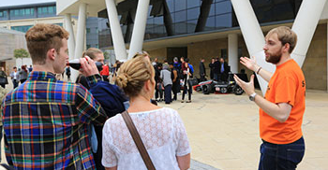
Additional sources of income
Part-time jobs
Summer/gap year work
Sponsorship
Parental support

Slide 12
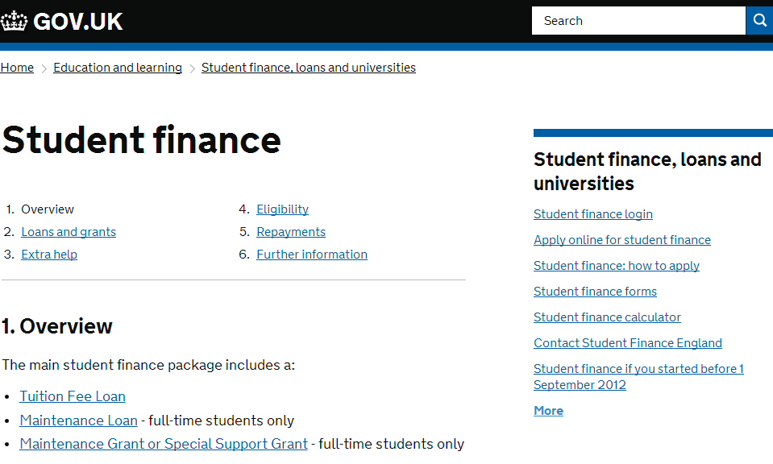
How do you get it?
Apply online at gov.uk/student-finance between February and May – don’t miss the 26th May deadline!
You don’t need a confirmed place at university to apply for student finance – simply state your preferred course choice. You can change this later.

Slide 13
When and how to repay
You’ll repay 9% of your income over £21,000 and if you’re employed deductions will be made from your pay through the HMRC tax system.
Income each year before tax | 9% will be deducted from | Monthly repayment (Approx)
£21,000 | £0 | £0
£25,000 | £4,000 | £30
£30,000 | £9,000 | £67
£40,000 | £19,000 | £142
£50,000 | £29,000 | £217
!
i
Interest is applied to your loan at a maximum rate of RPI +3%
More info can be found on: www.studentloanrepayment.co.uk

Slide 14
When and how to repay
Monthly repayments begin the April after graduation but will not start until your income exceeds £21,000.
+£21k
Your monthly repayments will be based on your earnings, not on your loan amount.
If your income falls to £21,000 or below your repayments will stop. Any outstanding loan balance will be written off 30 years after entering repayment.

Slide 15
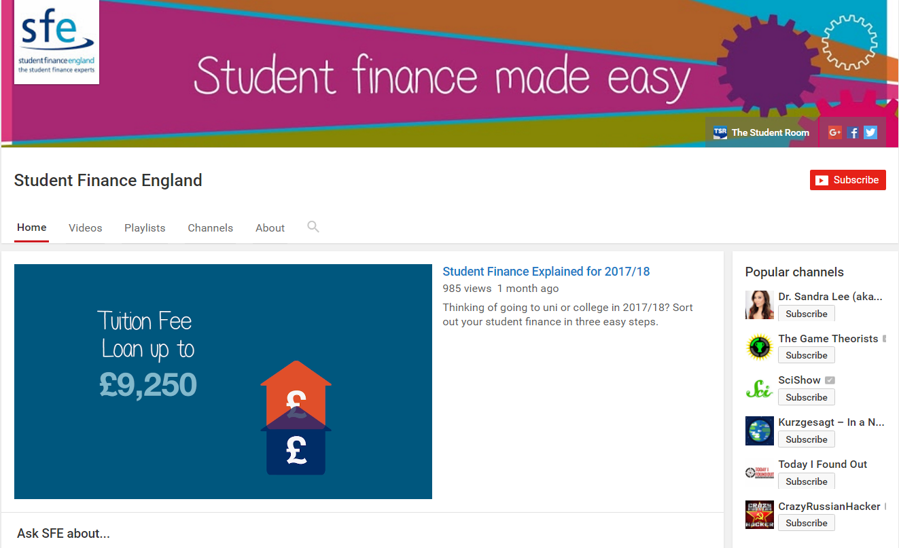
Re-cap

Slide 16
Managing your money
£
Plan a budget before starting university
Consider having two bank accounts (with the same bank) for bills and day to day spending
Prioritise essential spending (accommodation, food, travel) before luxuries (going out etc.)
Consider extra sources of income (part-time work, parental support) before starting university.
Re-apply for student finance for each year you’re at university.

Slide 17
Typical student expenditure What do you think?
Accommodation
Food, drink and essentials
Entertainment
Text books and course materials
Expect to pay £80-£120 per week for student accommodation (inc. bills).
Expect to pay £25-£50 a week on your shopping.
Travel
Discounts are available on bus and rail travel.
Buy an NUS Extra card (£12 per year) for savings on shopping, restaurants, cinema etc.
Text books can be expensive (e.g. £30 each), but you can borrow books from the library or pick up discounted and second-hand books on campus.

Slide 18
Where to find out more
Student finance information and forums on The Student Room.
Travel
Student finance applications and information at gov.uk/student-finance
Student finance information from the University of Huddersfield

Slide 19
Key things to remember
Tuition fees can be covered in full by a tuition fee loan.
Maintenance loans are available to help cover living costs and the amount you receive depends on your household income and circumstances.
Additional sources of income, including part-time jobs and parental support can also help cover living costs.
Loan repayments do not begin until you have graduated and are earning over £21,000. Monthly repayments are based on your earnings, not on how much loan you received.

Slide 20
Open Days 2017 Wednesday 21 June Thursday 22 June Saturday 16 September Saturday 21 October Wednesday 8 November Friday 1 December 9.30am – 3.00pm

