Slide 1

The North Halifax Grammar School
UCAS Application Evening
Miss S Adams
Year Group Leader for Year 12

Slide 2
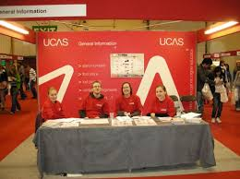


Pre-application Research
PSCHEE Programme
Higher Education Fair
(Leeds Beckett UCAS day
Wednesday 28th June 2017)
Open Days and Taster Days
www.opendays.com
Careers Interviews

Slide 3
PSCHEE Programme
Introduction to resources available;
Understanding jargon;
Researching courses;
Selecting and comparing universities;
Open Days;
The UCAS application process;
Writing the personal statement;
Presentations on apprenticeships and gap years from guest speakers.

Slide 4






Pre-application Research
Prospectuses
Handbooks and guides
Course leaflets
Subject specific books
Subject teachers
Form tutors
Internet

Slide 5
Useful internet websites
http://www.thecompleteuniversityguide.co.uk/
https://www.theguardian.com/education/ng-interactive/2016/may/23/university-league-tables-2017
http://unistats.direct.gov.uk/
http://university.which.co.uk/courses

Slide 6
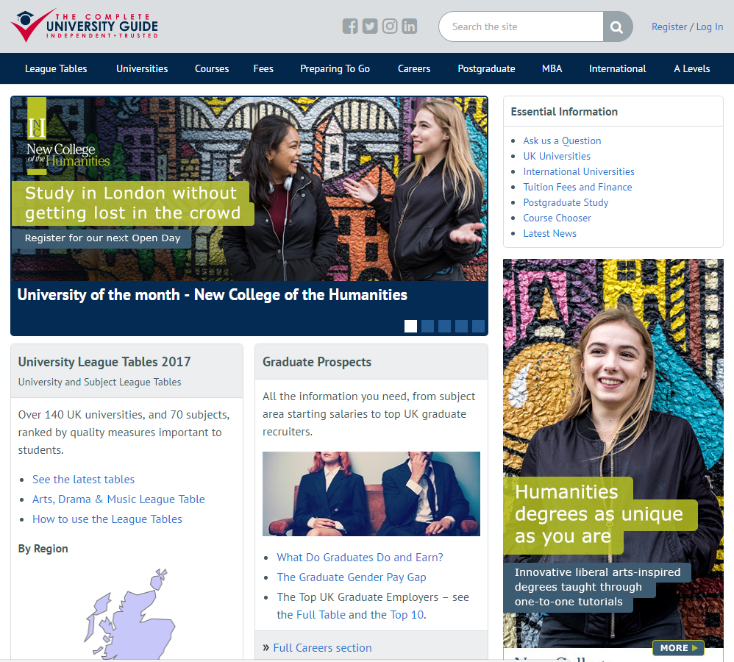

Slide 7
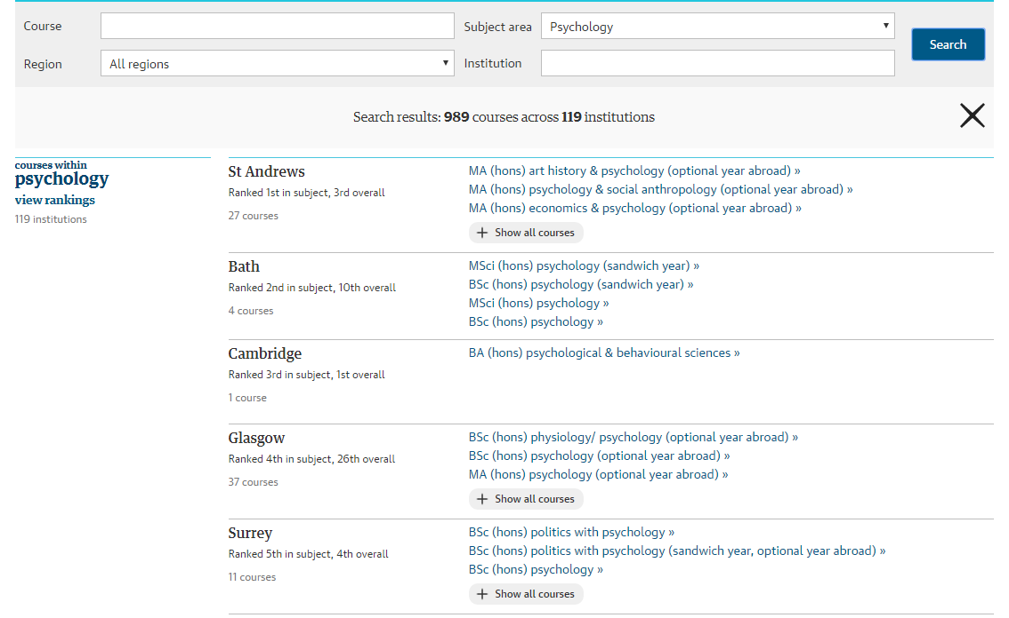

Slide 8
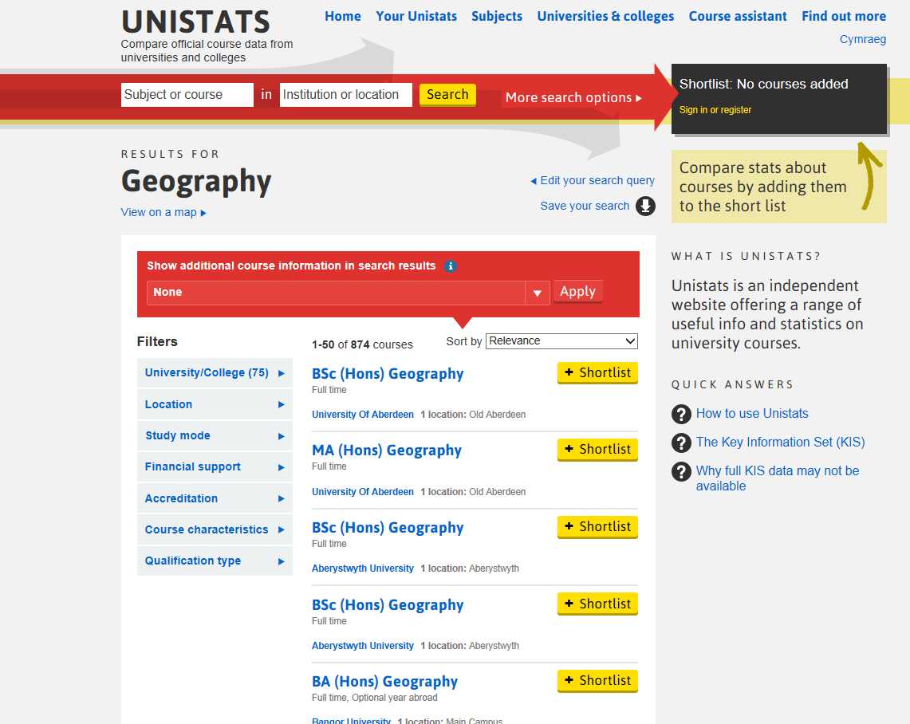

Slide 9
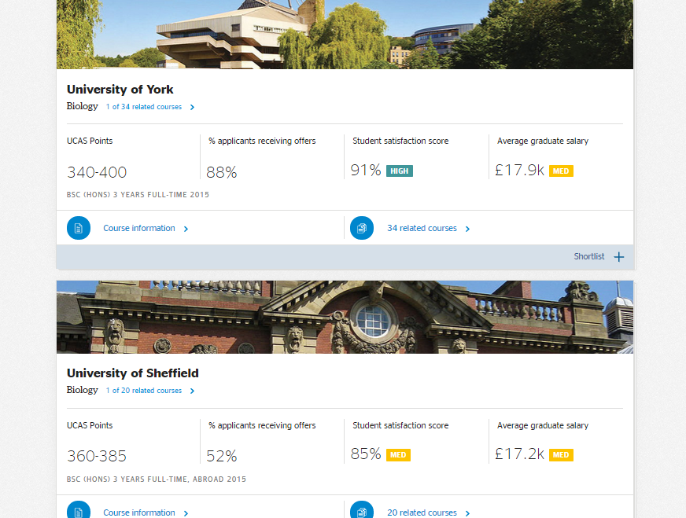

Slide 10





The UCAS website
www.ucas.com
Course search and minimum entry requirements
Links to university websites
Advice for parents http://www.ucas.com/parents/
Student finance https://www.ucas.com/ucas/undergraduate/finance-and-support
http://www.ucas.tv/
You can also get updates/advice about UCAS on Facebook and Twitter or download the UCAS app.
We are now going to watch a sort clip on the UCAS process
https://www.ucas.com/ucas/undergraduate/getting-started

Slide 11
UCAS tariff
A Level
AS
Grade Tariff points
A* 56
A 48
B 40
C 32
D 24
E 16
Grade Tariff points
A 20
B 16
C 12
D 10
E 6
Extended Project Qualification is worth 50% of A level qualification tariff

Slide 12
The UCAS process at NHGS
Process starts on UCAS Day during Activities Week Monday 3rd or Wednesday 5th July;
ALL AS externally accredited examinations to be included on application including U grades;
UCAS accept applications from mid September;
Process will be coordinated by Form Tutors and monitored by the Sixth Form Team (SAA, RAP, GQ, JD and PAJ);
Oxbridge applications – NKW;
Parental Involvement.

Slide 13
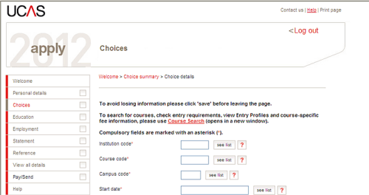
The UCAS application
EAS (Electronic Application System)
GAP Year – students can apply for deferred entry.
Work Experience – this is particularly important for medicine, physiotherapy, teaching, law, veterinary science, nursing and midwifery applicants.

Slide 14
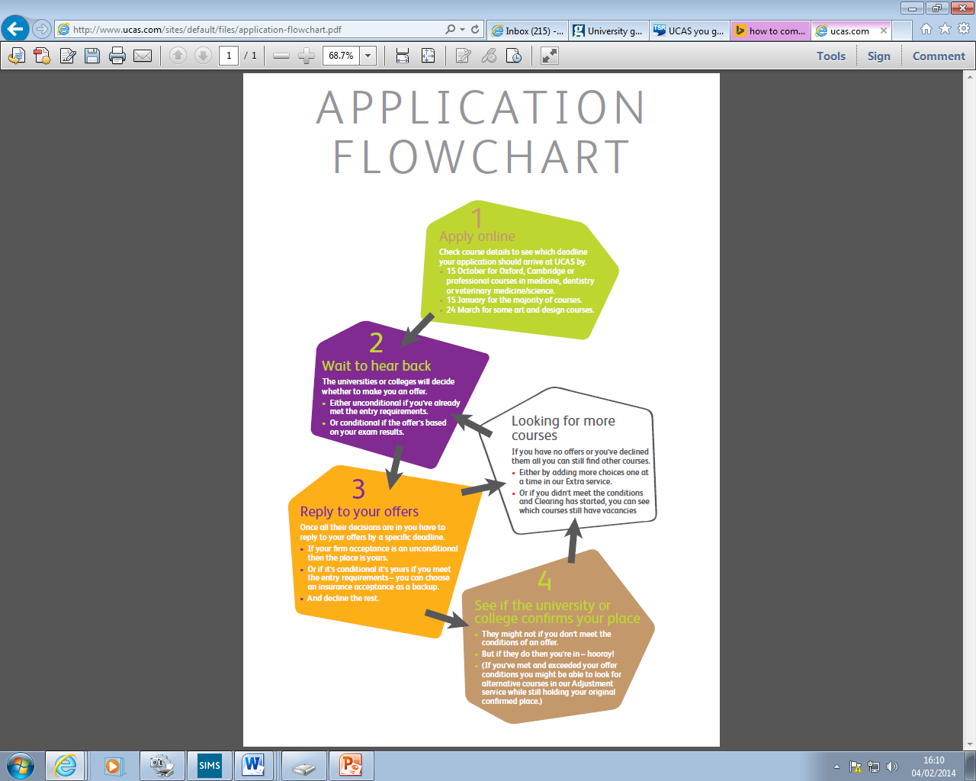

Slide 15
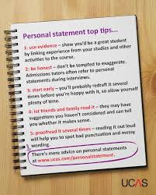
Personal statement – start early
Personal statements are so important, make sure you include:
Why you are interested in the subject;
Your enthusiasm for the subject;
How your previous studies relate to the course(s) you are applying for;
Relevant aspects of jobs, placements; work experience or volunteering;
Why you think you are a suitable candidate (your skills and the qualities they are looking for);
Activities or hobbies that show your interest in the subject and any training or achievements that show your skills.

Slide 16

Personal statement – start early
The questions universities and colleges will ask:
Have they chosen the right subject for the right reasons?
Do they have a range of interests?
Does the personal statement confirm their interest in the subject?
Have they studied independently?
Are they motivated and committed?
Do they possess good numeracy and literacy skills?

Slide 17
Applications for Art and Design courses
Apply through the normal route for university courses;
Two application deadlines – 15th January & (24th March for some courses);
One-year art foundation courses - apply direct to the university or college;
Most courses will expect a portfolio;
Applications to be coordinated by Mrs Quigley.

Slide 18
Applications for music, dance, drama or screen production courses at conservatoires
Apply through CUKAS
http://www.cukas.ac.uk/students/
Application deadlines – 1st October for music applicants and 15th January for all others;
You will be expected to audition;
Applications to be coordinated by Miss Adams.

Slide 19

Post UCAS application
UCAS Track – enables students to see what is happening with their application;
An admission tutor can make one of three decisions after reviewing applications:
  Unconditional offer;
  Conditional offer;
  Unsuccessful.

Slide 20

Post UCAS application
Interviews - Formal and informal. Interview preparation in school through PSCHEE and mock interviews;
Applicant days/Departmental visits;
Discussions with form tutor and assistance from Sixth Form Team;
UCAS Extra – offers support for students who have not received any offers.

Slide 21
Post application – August 2018
Confirmation, Clearing and Adjustment
Exam results are published – many are passed electronically to universities by UCAS.
September/October 2018 – Students commence their courses

Slide 22

Confirmation
Admissions staff check if the applicant has met the conditions of the offer.
There are four possibilities:
1. If a student meets the conditions of their firm choice. It’s time to celebrate!
2. If a student doesn’t meet the conditions of their firm choice, but meets the conditions of their insurance choice (which should be lower), they will be placed at their insurance choice. It’s also time to celebrate!
4. If a student meets and exceeds the conditions of their offer, they are eligible for Adjustment. This provides an opportunity for them to reconsider where and what to study whilst still holding their firm offer.
3. If a student has not met the conditions of their firm or insurance choice (or no insurance), they will be entered into a process known as Clearing.

Slide 23
Deadlines
15th October 2017
Oxbridge/Medicine/Dentistry/Veterinary applications
Friday 27th October 2017
School deadline for receipt of all other applications (guarantee that applications will be sent by UCAS final deadline)
Applications will not be processed after 22nd December.
15th January 2018 UCAS final deadline
Universities should make decisions by 31st March but they can take longer.
Applications received by the key deadlines are given equal consideration.

Slide 24
School points of contact
Mrs G Quigley – Sixth Form Leader
Miss S Adams – Year Group Leader for Year 12
Mrs R Pegg – Year Group Leader for Year 13
Mr J Downing – Enrichment Coordinator
Mr P Jervis – Vice Principal (Curriculum & Sixth Form)

